Slide 1
AI IN AGILE SYSTEMS
DIABETIC RETINOPATHY DETECTION USING IMAGE CLASSIFICATION
Akshay Krishna-RA2011033010001 Shruti Sawarn-RA2011033010042 Gayatri Malladi-RA2011033010047

Slide 2
INDEX
1.Problem statement
2.Objectives
3.Functionalities and computing resources
4.Compare and contrast alternative solutions-methods to select best method
5.Design constraints for required performance criteria

Slide 3
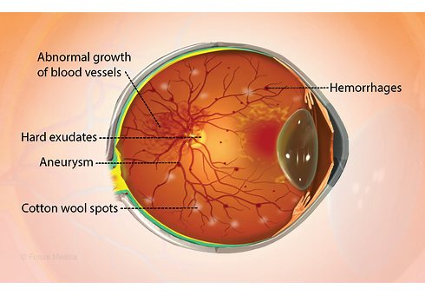
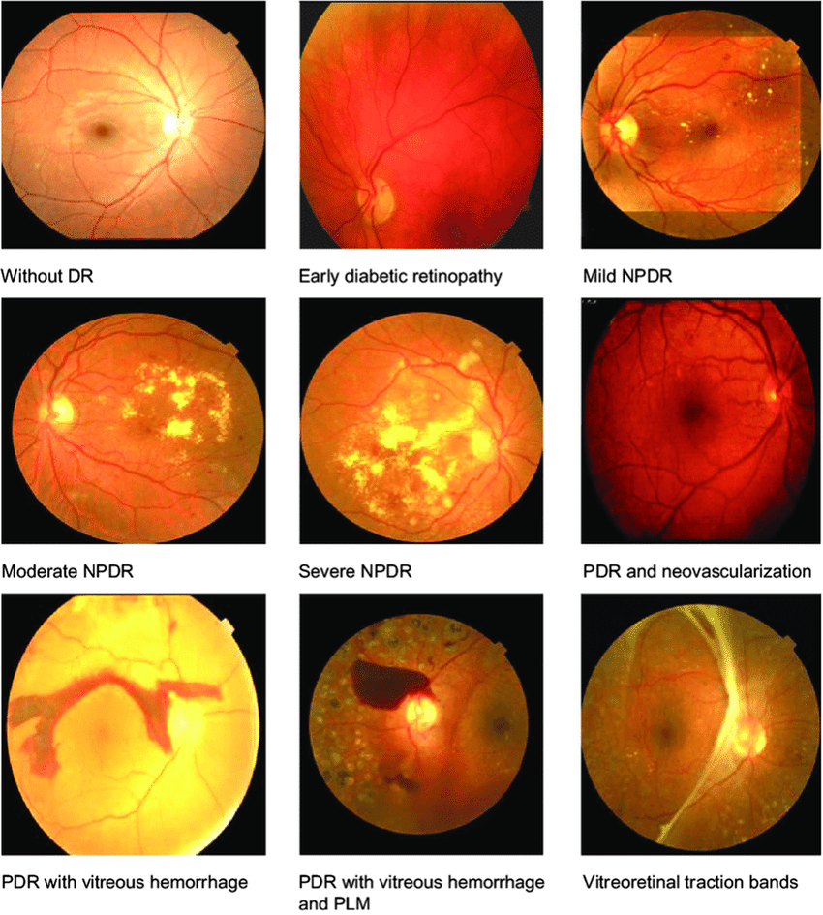
WHAT IS DR?

Slide 4
PROBLEM STATEMENT
Millions of people suffer from Diabetic retinopathy i.e a serious condition that can lead to vision problems and blindness, the leading cause of blindness among working aged adults.
Occurs when the damaged blood vessels leak blood and other fluids into your retina, causing swelling and blurry vision. The blood vessels can become blocked, scar tissue can develop, and retinal detachment can eventually occur.
Of those with diabetes, approximately one-third are expected to be diagnosed with diabetic retinopathy (DR), a chronic eye disease that can progress to irreversible vision loss
The manual nature of DR screening methods promotes widespread inconsistency among readers. Finally, given an increase in prevalence of both diabetes and associated retinal complications throughout the world, manual methods of diagnosis may be unable to keep apace with demand for screening services.

Slide 5
OBJECTIVES
The objective of our project is to find and implement the best method for computer-aided diagnostics of diabetic retinopathy to reduce the burden on ophthalmologists and mitigate diagnostic inconsistencies between manual readers.
To perform high bias , low variance digital image processing technique s for identifying one specific feature used in detection of subtle disease such as use of top-hat algorithm for microaneurysm detection.
To determine the sensitivity and specificity of our 4-ary classification model and evaluate performance by comparing results to currently published research data.
0 — No DR
1 — Mild
2 — Moderate
3 — Severe
4 — Proliferative DR
The above mentioned are the scale of of severity of diabetic retinopathy

Slide 6
FUNCTIONALITIES
Identify features like micro-aneurysms and hemorrhages on the retina
Classifying retinal blood vessels to automatically detect stages of Diabetic Retinopathy and providing appropriate treatment to Diabetic Retinopathy patients.
The deep architecture is framed to learn features in a hierarchical manner with feature at a level being formed by composition of features at lower levels.
software use different python module for various pre-processing technique of image and detect the Retinopathy using convolutional neural networks by dividing the image into different sub layers

Slide 7
COMPUTING RESOURCES
System requirements:
Multiple computers in sync as servers
8Core 4GHz each
16GB RAM for each Core
Massive databank HDDs
Network connectivity
Disk storage
UPS and Surge protector (backup power)
SaaS-Software as a service

Slide 8
Compare and contrast alternative solutions
The diabetic retinopathy detection problem can be viewed from several angles: as a classification problem, as a regression problem, and as an ordinal regression problem. This is possible because stages of the disease come sequentially.
Several methods of detecting microaneurysms and grading DR involving k-NN, support vector machines, and ensemble-based methods have yielded sensitivities and specificities within the 90% range using various feature extraction techniques and pre-processing algorithms.
CNN studies for DR fundus images achieved sensitivities and specificities in the range of 90% for binary classification categories of normal or mild vs moderate or severe on much larger private datasets of 80,000 to 120,000 images.

Slide 9
WHY CNN-as the best solution method?
efficient network achieves state-of-the-art accuracy using a mixture of low-dimensional embeddings and heterogeneous sized spatial filters
Increased convolution layers and improved utilization of internal network computing resources allow the network to learn deeper features
As the number of feature maps increase, one batch normalization per block is introduced in succession.
The network uses convolutional layer L2 regularization to reduce model overfitting, cross-entropy computed error loss, and the Xavier method of initializing weights so that neuron activation functions start out in unsaturated regions.

Slide 10
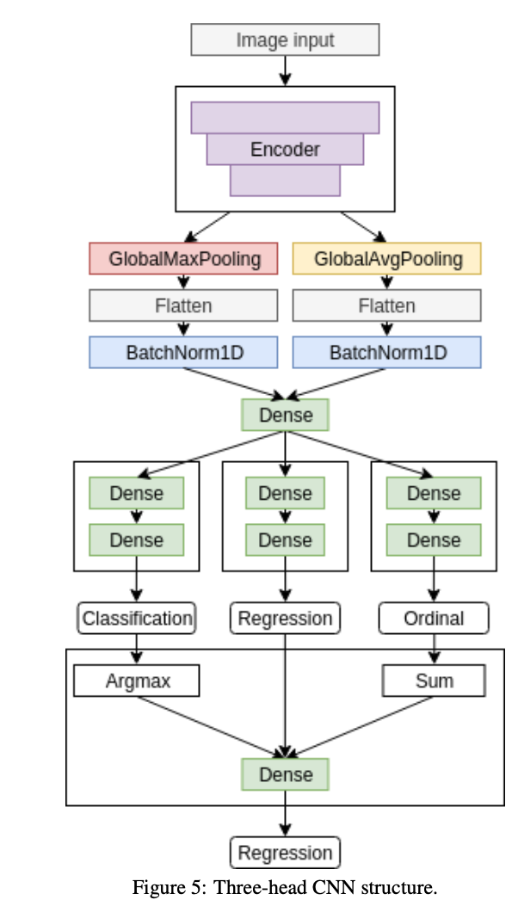

Slide 11
DESIGN CONSTRAINTS FOR REQUIRED PERFORMANCE CRITERIA
1.COMMERCIAL CONSTRAINTS-Time and budget
2.FUNCTIONAL-REQUREMENTS-specification of features for a website
○ Databases on shelters, census, transportation, resource
○ Statistics
○ User data: basic details, login credentials
3.NON-FUNCTIONAL REQUIREMENTS-
○ Durability
○ Availability
○ Reliability
○ Server farms

Slide 12
DESIGN CONSTRAINTS FOR REQUIRED PERFORMANCE CRITERIA
4.STYLE-A style guide or multiple style guides related to an organization, brand, product, service, environment or project.
5.SENSORY DESIGN
6.USABILITY-Usability principles, frameworks and standards.
7.EASE OF EXTENSIBILTY
8.CHANGE LOACALIZATION

